Slide 1
Data mining in unusual domains with information-rich knowledge graph construction, inference and search
Mayank Kejriwal, Pedro Szekely
Information Sciences Institute,
USC Viterbi School of Engineering

Slide 2
Agenda
Unusual domains
Knowledge graphs
KG construction
Case study
Knowledge graph completion
Entity resolution
Probabilistic soft logic
KGs in latent space
Searching knowledge graphs

Slide 3
Unusual domains

Slide 4
Disaster Assistance In Regions Using Low Resource Languages
Data
Social media and news in low resource languages
Akan, Amharic, Hausa, Tagalog, Uyghur, Wolof, Yoruba, …
Example Questions
Identify areas where people are in greatest need
Identify threats to relief personnel
Characterize the evolution of the disaster
Technical Challenges
Very noisy translation
Clustering documents according to need, location and entities
Streaming data

Slide 5
Identify Illegal Firearm Sales
Data
Classified ads and forums
Open and dark web
Example Questions
Identify buyers who purchase on behalf of others
Identify people who buy and sell without proper licenses
Identify vendors who illegally sell across state lines
Identify stolen firearms for sale
Technical Challenges
Most firearm sales are legal
Huge volume of pages and web sites
Unusual language model

Slide 6
Identify Counterfeit Electronics Vendors
Data
Online catalogs and forums
Internal sources containing suspicious vendors, shipping addresses
Example Questions
Identify clusters of companies under control of one organization
Identify fraudulent ads across vendor sites
Technical Challenges
Many pages in Chinese
Fake images on catalogs
Frequent creation of new shell vendor companies

Slide 7
Identify Narcotics Vendors In The Dark Web
Data
Dark web marketplace and forum pages
Open web social media sites
Example Questions
Identify dark web personas in the open web
???
Technical Challenges
Pages in multiple languages
Unusual language model
Deception, fake vendors, fake reviews
Careful concealment of identifying information

Slide 8
Combat Fraud In The Penny Stock Market
Data
Web pages and social media about companies in the Over The Counter (OTC) market
Example Questions
Identify in-progress pump-and-dump scams
Identify chain of shell companies and individuals involved
Identify promoters, attorneys, etc.
Identify evidence of unlawful behavior (e.g., false statements in promotional materials)
Technical Challenges
Pump-and-dump scams are carefully planned and controlled to look legal
Wide variety of page genres: company profiles, press releases, promotions, financial data

Slide 9
Identify Human-Trafficking Victims & Prosecute Traffickers
Data
100,000,000 escort ads published on the web
50,000 images
Example Questions
Identify all ads for an escort given soft identifies
Tag ads as high-risk for human trafficking
Identify stables of escorts controlled by one trafficker
Identify fake images
Identify networks of phone numbers
Technical Challenges
Noise, obfuscation, deception and large size
Unique language model
Long-tailed set of sources
Lack of identifiers and reference data

Slide 10
Work on unusual domains has significant
social impact

Slide 11
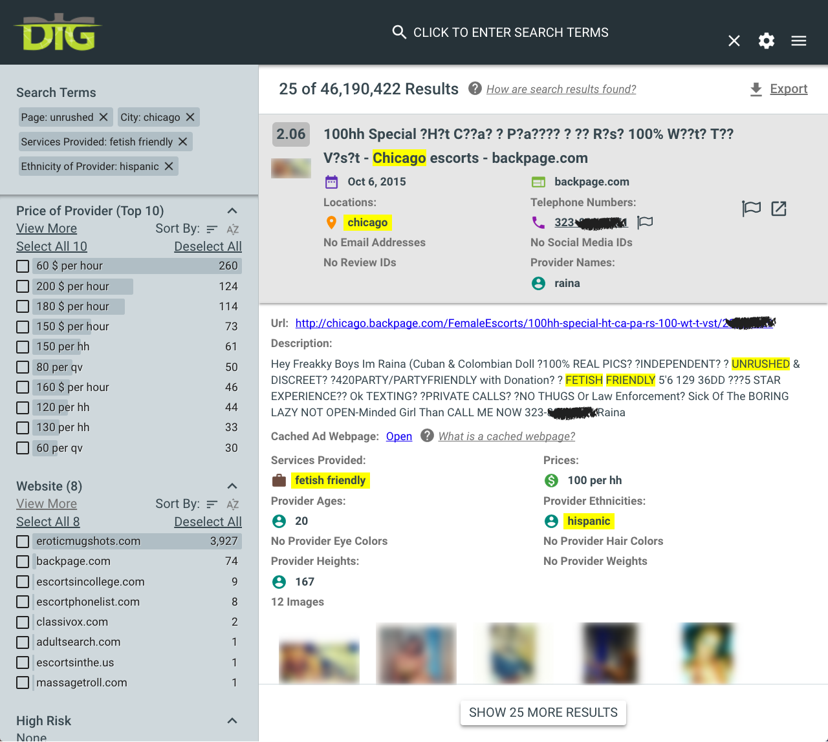
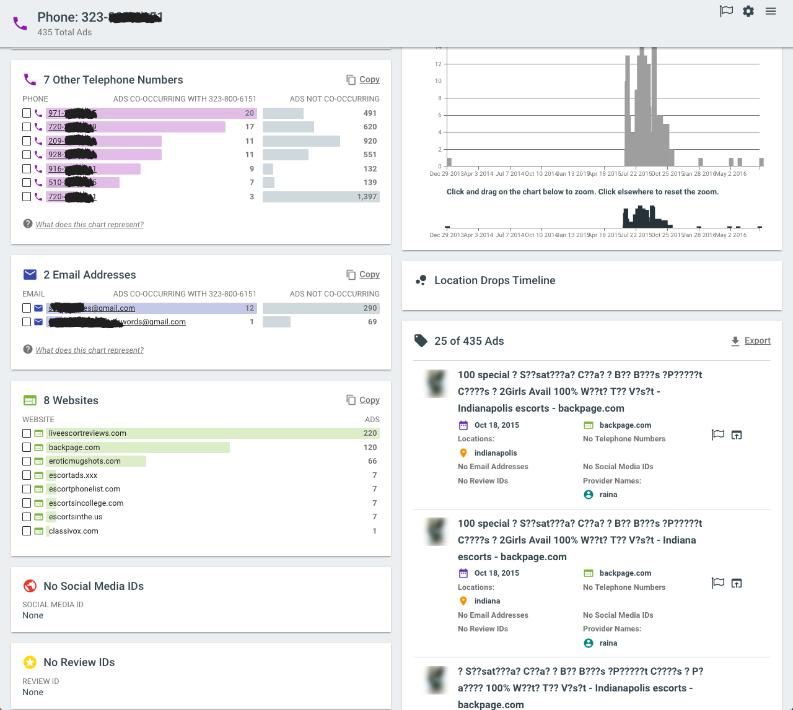
Find Locations Where An Escort Was Advertised

Slide 12
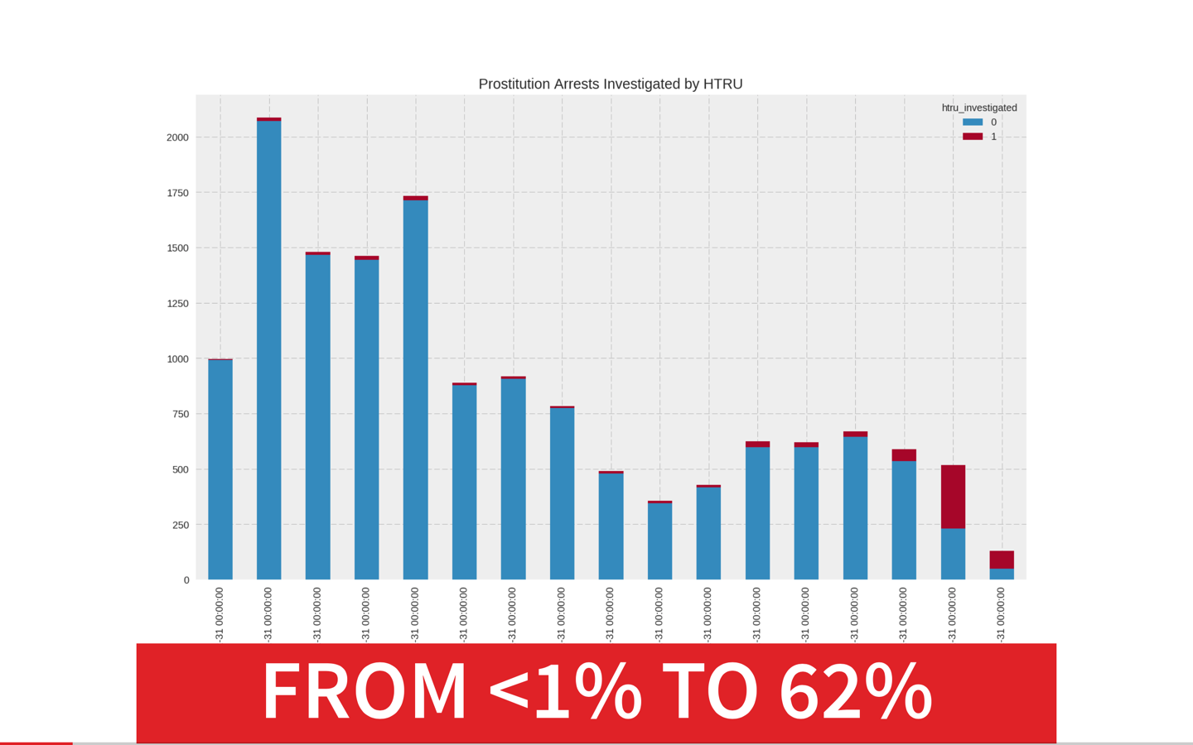
Number Of HT Investigations Increased
MEMEX

Slide 13
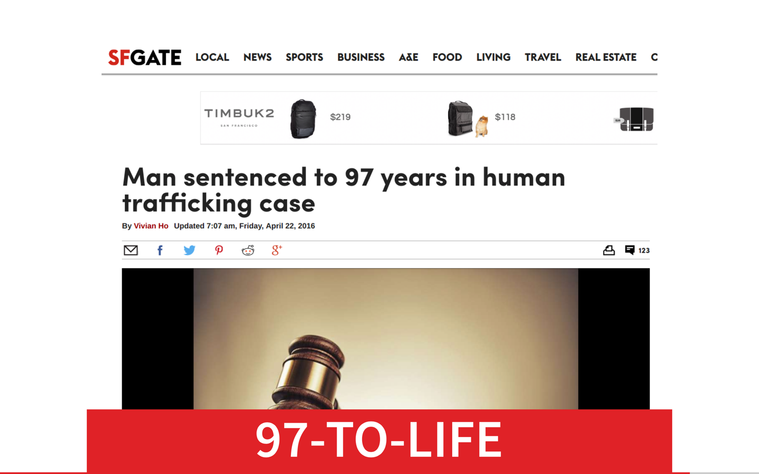

Slide 14
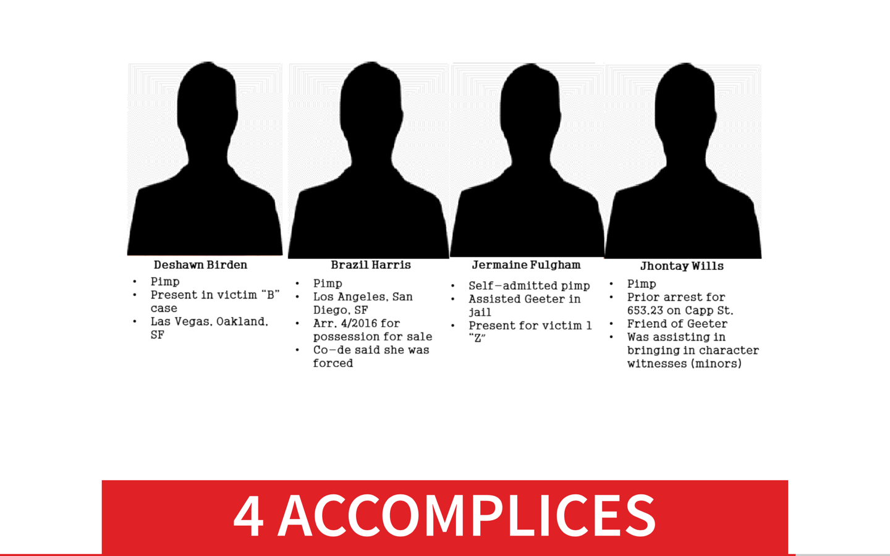

Slide 15
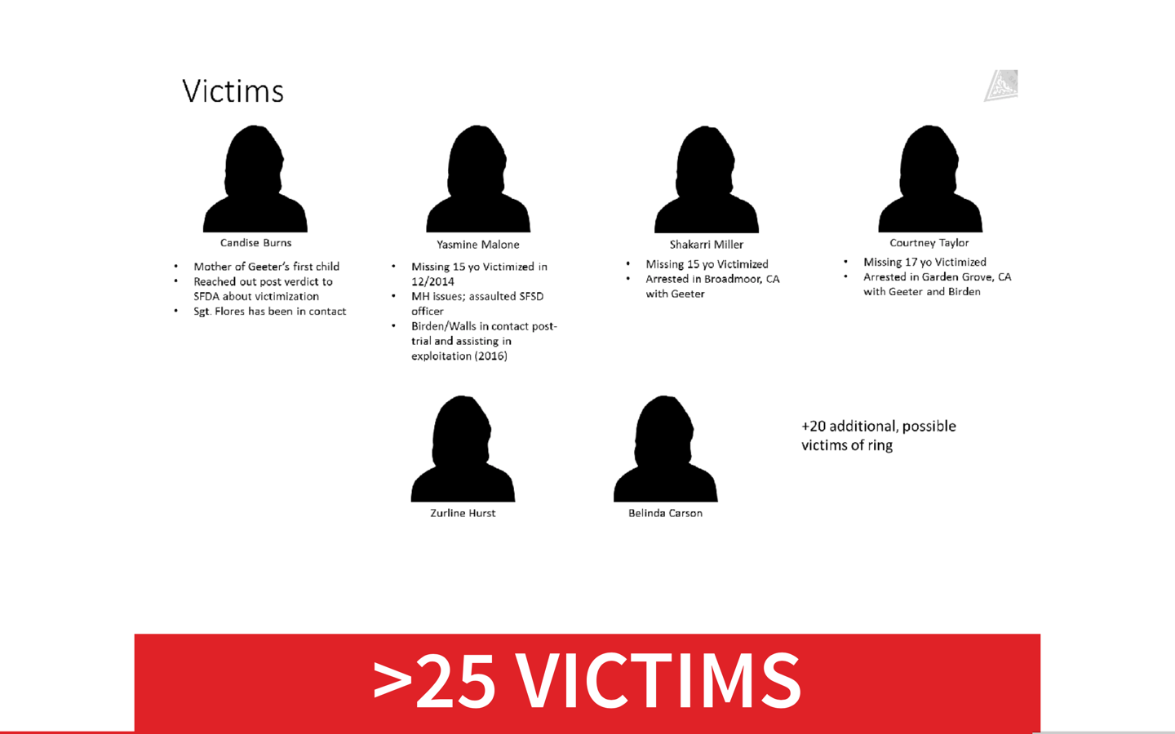

Slide 16
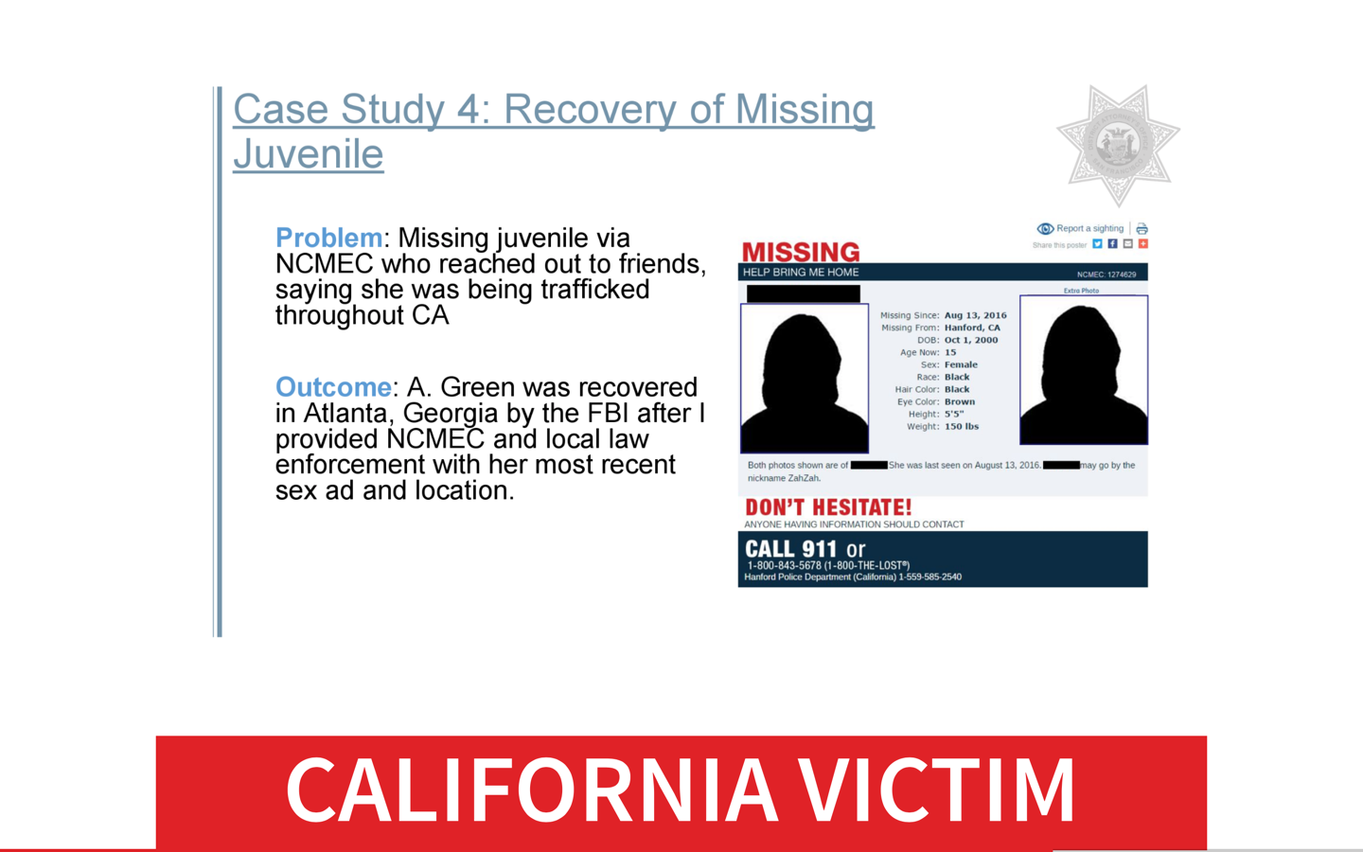

Slide 17
Usual | Unusual
Good English | Jargon, ungrammatical
Mostly correct information | Obfuscation & deception
Large reference datasets | No reference datasets
Small number of sources | Long tail
Sources readily available | Ephemeral pages, dark web, anti-crawling measures

Slide 18
Two guiding questions
How do we model, and represent knowledge in, unusual domains?
Are there general lessons to be learned across domains?
How do we do search and inference in unusual domains?

Slide 19
how to represent KGs?

Slide 20
KG Definition
a directed, labeled multi-relational graph representing facts/assertions as triples
(h, r, t) head entity, relation, tail entity
(s, p, o) subject, predicate, object

Slide 21
Simplest Knowledge Graph
Entities
LGYV
mentions
mentions
Legacy Ventures International Inc
mentions
Damn Good Penny Stocks
Easiest to build

Slide 22
Simple, But Useful KG
Entities + properties
LGYV
stock-ticker
company
Legacy Ventures International Inc
promoter
Damn Good Penny Stocks
“Easy” to build

Slide 23
Semantic Web KG (RDF/OWL)
Entities + properties + classes
LGYV
stock-ticker
Company
is-a
is-a
Legacy Ventures International Inc
promoter
Damn Good Penny Stocks
Very hard to build

Slide 24
“Ideal” KG
Entities + properties + classes + qualifiers
LGYV
stock-ticker
Company
is-a
is-a
Legacy Ventures International Inc
promoter
Damn Good Penny Stocks
source
stockreads.com
start-date
June 2017
Very very hard to build

Slide 25
How about Ontologies?

Slide 26
Ontologies?
Domain ontologies don’t exist for unusal domains
Build new one or extend existing one?
Deep or shallow?

Slide 27
Ontologies?
Goal is to help users solve problems
Let users tell you what entities matter to them
Build the shallowest, simplest ontology that captures the entities users care about

Slide 28
Ontologies?
Domain ontologies don’t exist for unusal domains
Build new one or extend existing one?
Deep or shallow?

Slide 29
Where to Store KGs?

Slide 30
Serializing Knowledge Graphs
Resource Description Framework (RDF)
Database (triple store): AllegroGraph, Virtuoso,
Query: SPARQL (SQL-like)
Key-Value, Document Stores
Data model: Node-centric
Databases: Hbase, MongoDB, Elastic Search, …
Query: filters, keywords, aggregation (no joins)
Graph Databases
Data model: graph
Databases: Neo4J, Cayley, MarkLogic, GraphDB, Titan, OrientDB, Oracle, …
Query: GraphQL, Gremlin, Cypher
Notes:
Cover definitions, pros and cons

Slide 31
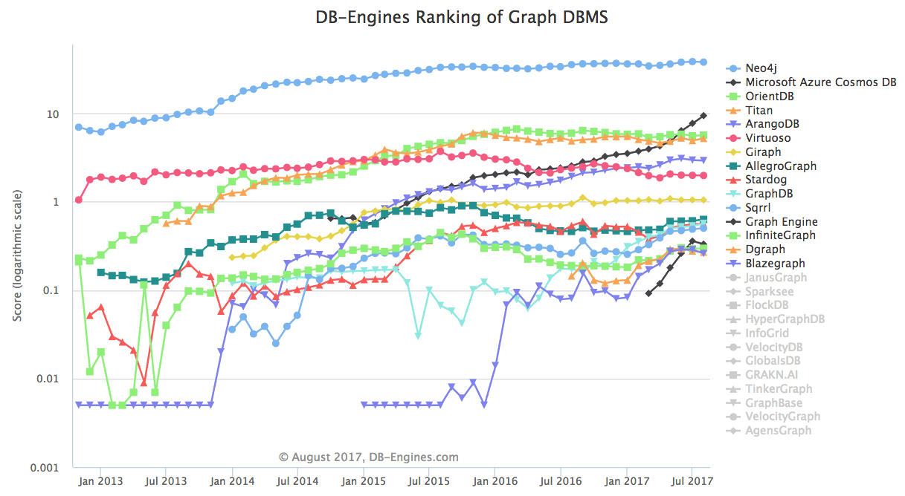
Popularity Ranking Of Graph Databases
https://db-engines.com/en/ranking_trend/graph+dbms

Slide 32
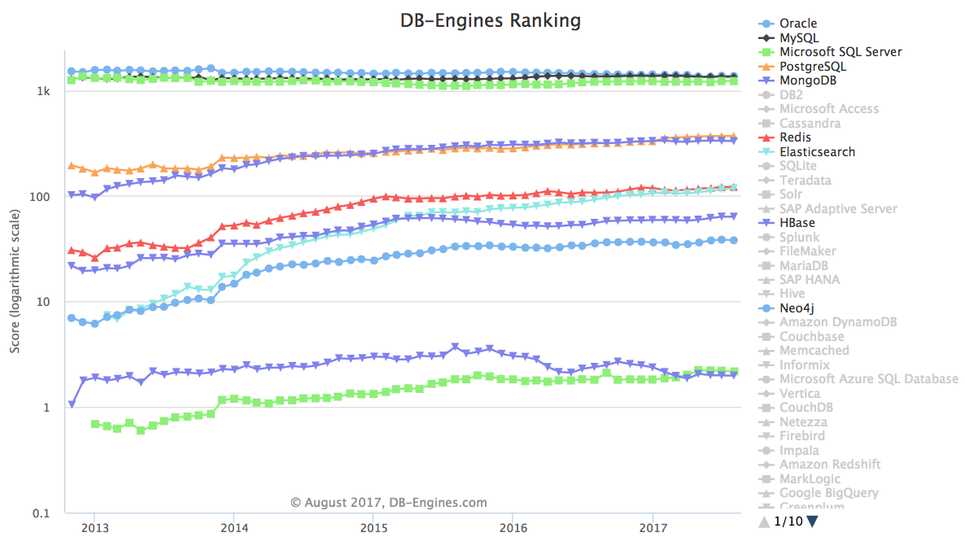
ElasticSearch, MongoDB & Neo4J Have Wide Adoption
Triple Stores
https://db-engines.com/en/ranking_trend/graph+dbms

Slide 33
KGs I can Reuse

Slide 34
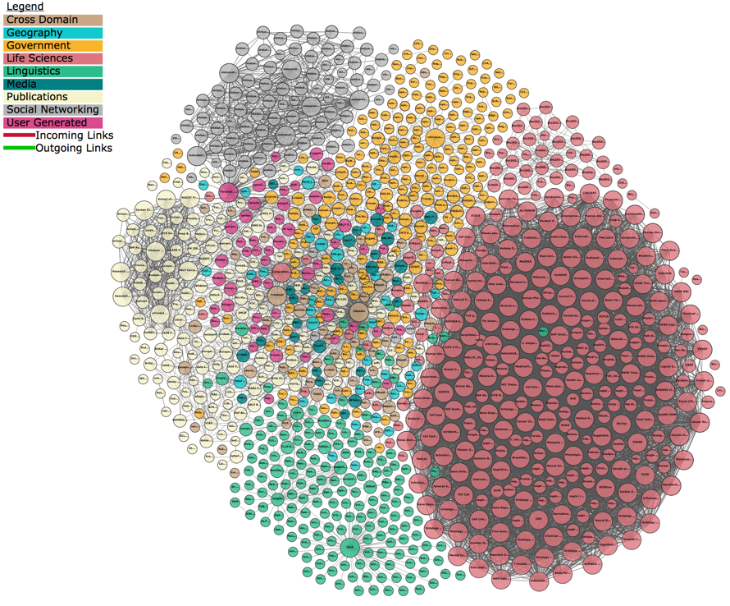
Linked
Open
Data
Cloud

Slide 35
DBpedia RDF graph derived from Wikipedia http://wiki.dbpedia.org/
4.58 million things
4.22 million are classified in a consistent ontology
1,445,000 persons
735,000 places
478,000 populated places),
411,000 creative works
123,000 music albums, 87,000 films and 19,000 video games
241,000 organizations
58,000 companies and 49,000 educational institutions
251,000 species
6,000 diseases
Notes:
Describe the highlights of each case study, with a particular emphasis on application

Slide 36
YAGO Knowledge Base http://www.mpi-inf.mpg.de/departments/databases-and-information-systems/research/yago-naga/yago/downloads
Derived from Wikipedia WordNet and GeoNames
10 million entities
120 million assertions persons, organizations, cities, etc.
350,000 classes
many fine grained classes, inferred from the data

Slide 37
Wikidata The ”wikipedia” of data https://www.wikidata.org/wiki/Wikidata:Main_Page
Collaborative, multilingual
collecting structured data to provide support for Wikipedia
31,419,072 items
534,615,360 edits since the project launch

Slide 38
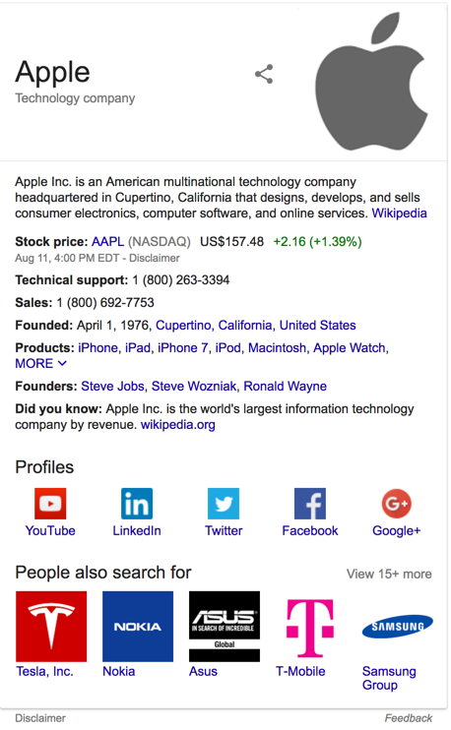
Google Knowledge Graph
https://developers.google.com/knowledge-graph/how-tos/search-widget-example
search: APPL
derived from many sources, including the CIA World Factbook, Wikidata, and Wikipedia
powers a "knowledge panel"
the Knowledge Graph now holds 70 billion facts

Slide 39
Other Knowledge Graphs
Internet Movie Firearms Database
Firearms used or featured in movies, television shows, video games, and anime
22,159 articles, extensive coverage and ontology
http://www.imfdb.org/wiki/Category:Gun
Microsoft Satori
Large knowledge graph similar to Google KG, e.g., 1.8 million bottles of wine
Many streaming channels of real-time data, e.g., bitcoin, transportation, …
https://www.satori.com/
LinkedIn Knowledge Graph
450M members, 190M historical job listings, 9M companies, 28K schools,
1.5K fields of study, 600+ degrees, 24K titles and 35K skills in 19 languages
https://engineering.linkedin.com/blog/2016/10/building-the-linkedin-knowledge-graph

Slide 40
Knowledge ‘base’ vs ‘graph’
Terms often used interchangeably in the literature
Knowledge base is more of a catch-all e.g., Wikipedia vs. DBpedia
We use the term ‘knowledge graph’ where possible
Notes:
Give some references to show which ones use base, which ones use graph

Slide 41
Why Knowledge Graphs? Combine advantages of databases and unstructured text
Machine and human understandable
Useful in search and data mining
Many interesting extensions
Interest in multiple communities incl. NLP, data mining…
Many more!
Notes:
This and the next two slides are extremely text heavy. May want to break it up and use examples

Slide 42
KGs in Unusual domains

Slide 43
Knowledge Graphs In Unusual Domains Many challenges (and frontier research questions)!
Data skew
Lack of training data
Importance of data exploration
Keeping domain experts in the loop
Multi-faceted prediction and inference
Scalability
…

Slide 44
KG For Unusual Domains Entities + properties + provenance + confidence + qualifiers
Simple, shallow ontology
customized to domain, if not needed, leave it out
Rich provenance and confidences
essential for end-users, useful for knowledge graph improvement
Hybrid text/structured representation
keep the text, essential for machine learning and search
“Easy” to build

Slide 45
KG For Unusual Domains Entities + properties + provenance + confidence + qualifiers
“Easy” to build

Slide 46
Knowledge Graph Construction

Slide 47
How can I build a KG?

Slide 48
KG Construction Problem
Web
> 10¹³ pages
Databases
Knowledge
Graph

Slide 49
Steps To Build a KG
Web
> 10¹³ pages
Knowledge
Snippets
Crawling
~10⁸ pages
Information
Extraction
Databases
Knowledge
Graph
Construction
Knowledge
Graph

Slide 50
Crawling the web

Slide 51
The web is very BIG
Web
Google Index
Deep Web
Dark
Web

Slide 52
We can only get a tiny part
Web
Google Index
Deep Web
Dark
Web

Slide 53
Crawling Research Challenges
Domain discovery
Identifying relevant sites, datasets and pages
Crawling
Building models of relevant content
Identifying new content
Downloading dynamic content
Overcoming anti-crawling measures
Exhibiting human-like behavior

Slide 54
Crawling Tools
Scrapy (targeted crawling)
Open source and collaborative framework for extracting data from websites
https://scrapy.org/ACHE
Apache Nutch (massive crawling)
highly extensible, highly scalable Web crawler
http://nutch.apache.org
Deep Deep (Adaptive crawler)
reinforcement learning to learn which links to follow
https://github.com/TeamHG-Memex/deep-deep
ACHE (focused crawler)
https://github.com/ViDA-NYU/ache
ScrapingHub (service)
https://scrapinghub.com/data-on-demand

Slide 55
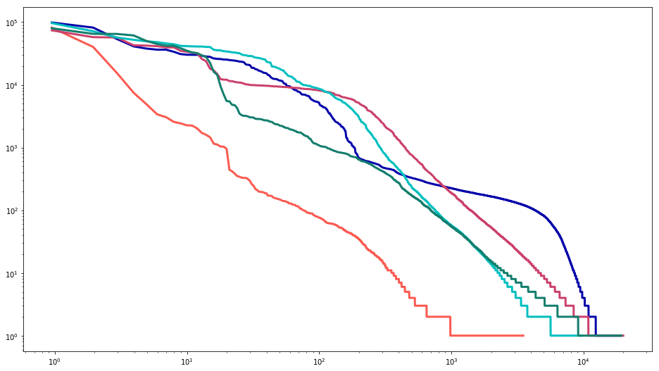
Unusual Domains Have Long Tails
10⁵
SEC
USPS
Count of crawled pages (log scale)
Narcotics
ATF
CE
10⁴
Web sites (second level domains), ordered by number of pages (log scale)

Slide 56
principles and challenges in Information Extraction

Slide 57
Information Extraction (IE)
Knowledge
Snippets
Documents

Slide 58
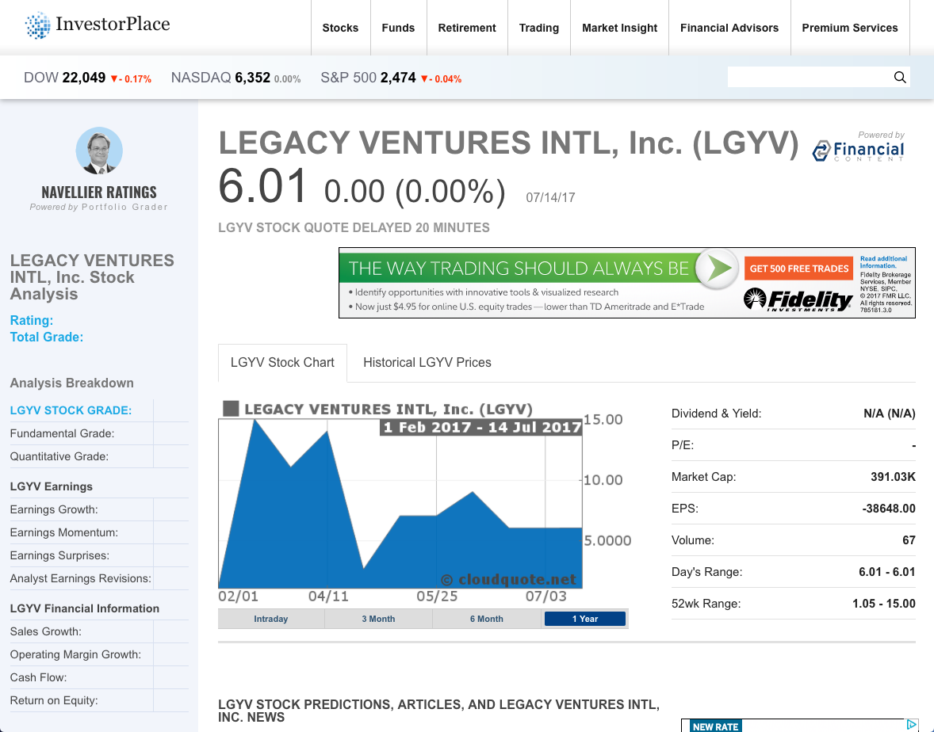
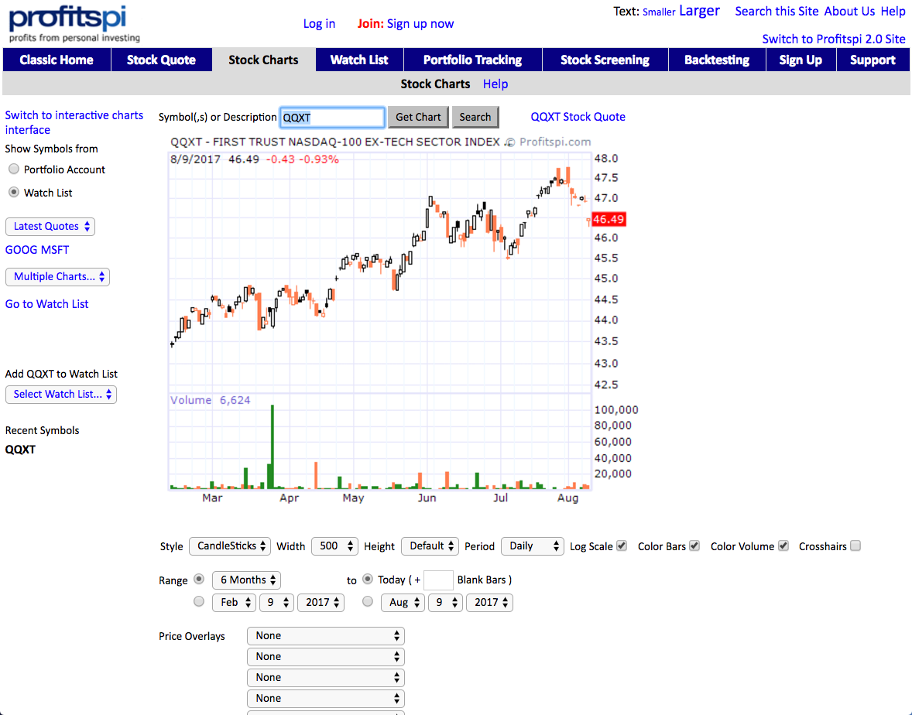
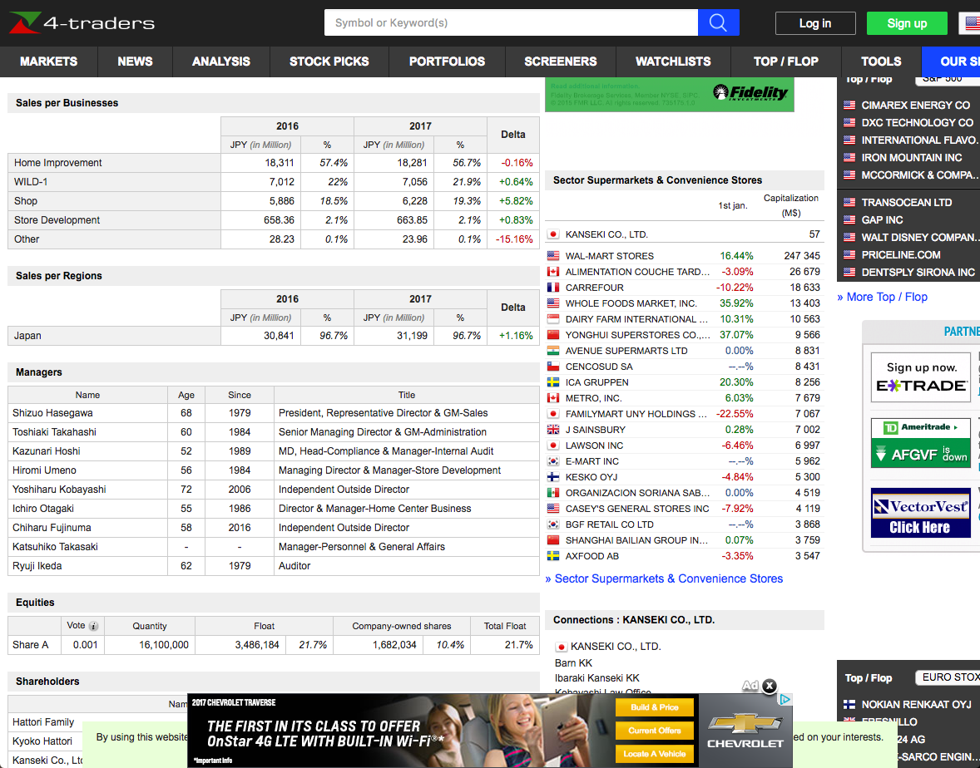
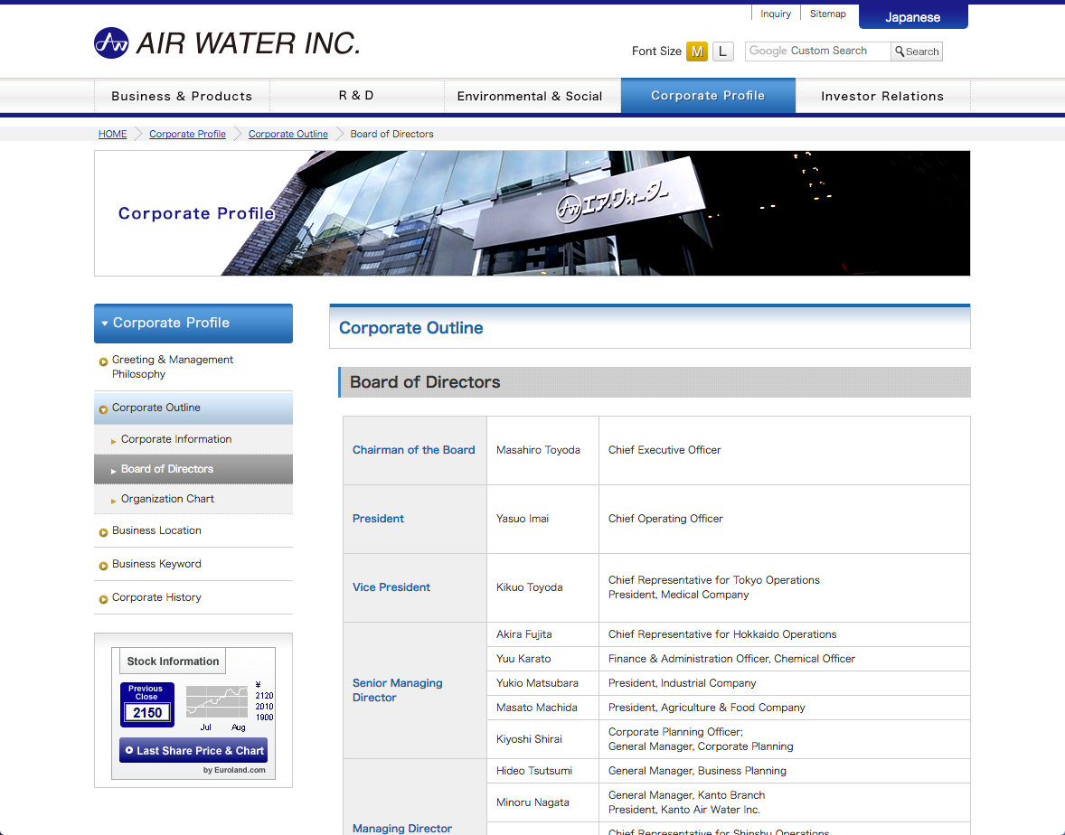
IE On The Web Is Challenging
Less grammar, more formatting & linking
Newswire
Web
Apple to Open Its First Retail Store
in New York City
MACWORLD EXPO, NEW YORK--July 17, 2002--Apple's first retail store in New York City will open in Manhattan's SoHo district on Thursday, July 18 at 8:00 a.m. EDT. The SoHo store will be Apple's largest retail store to date and is a stunning example of Apple's commitment to offering customers the world's best computer shopping experience.
"Fourteen months after opening our first retail store, our 31 stores are attracting over 100,000 visitors each week," said Steve Jobs, Apple's CEO. "We hope our SoHo store will surprise and delight both Mac and PC users who want to see everything the Mac can do to enhance their digital lifestyles."

Slide 59
Dimensions of IE
Document features
Scope
Pattern complexity
Relevance

Slide 60
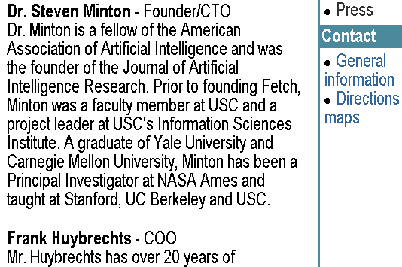
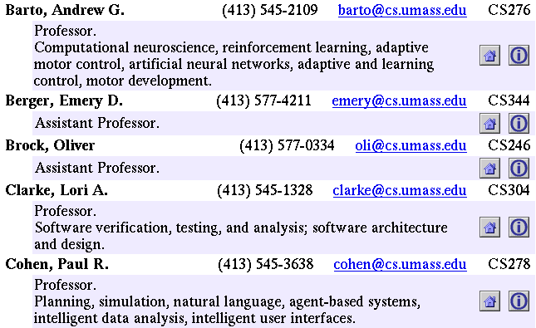
Document Features
Text paragraphs
without formatting
Astro Teller is the CEO and co-founder of BodyMedia. Astro holds a Ph.D. in Artificial Intelligence from Carnegie Mellon University, where he was inducted as a national Hertz fellow. His M.S. in symbolic and heuristic computation and B.S. in computer science are from Stanford University. His work in science, literature and business has appeared in international media from the New York Times to CNN to NPR.
Grammatical sentences plus some formatting & links
Non-grammatical snippets, rich formatting & links
Tables
Charts
Courtesy of Andrew McCallum

Slide 61
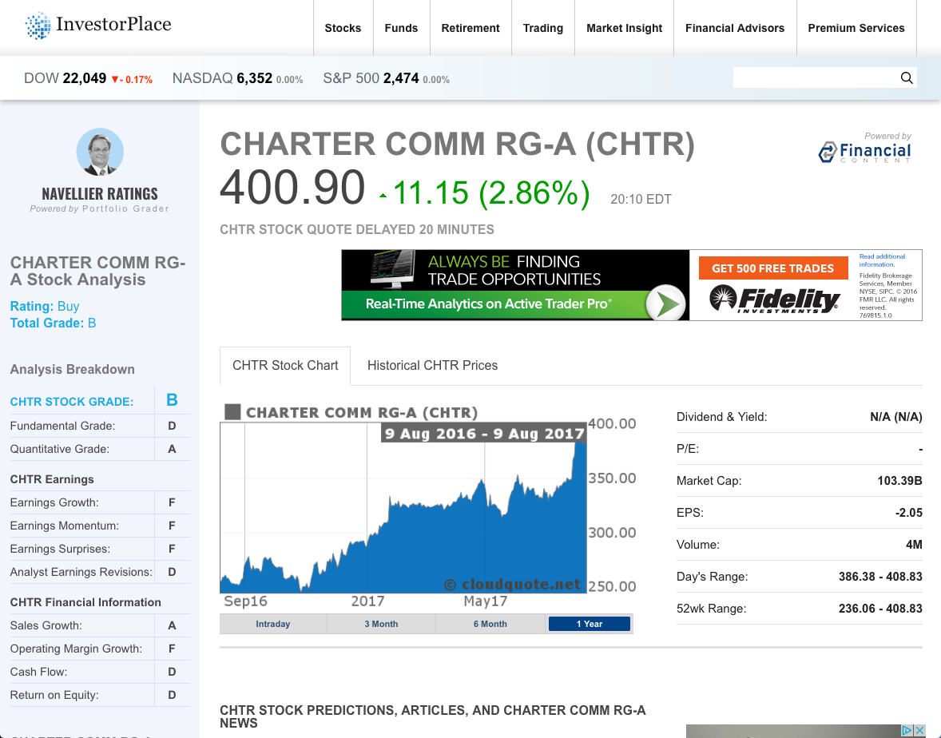
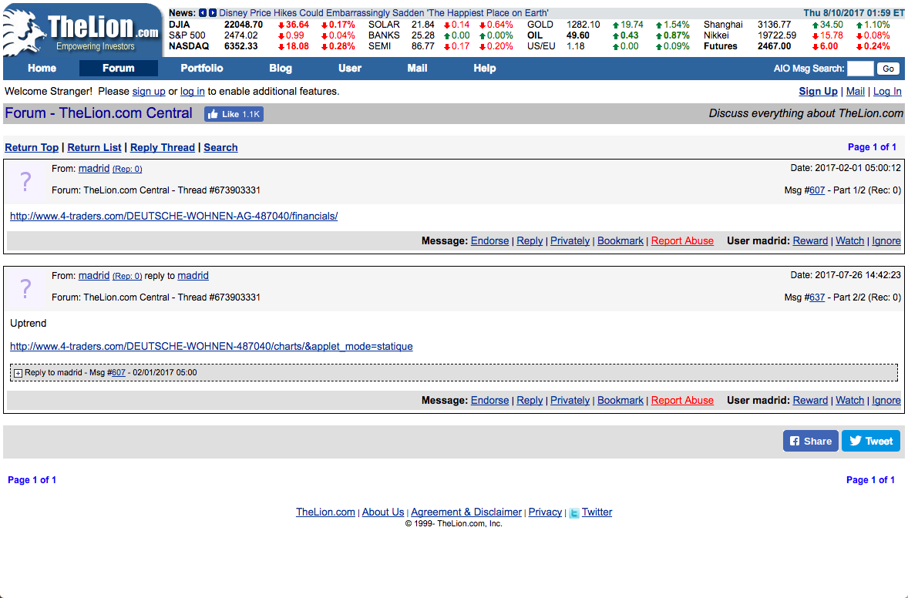
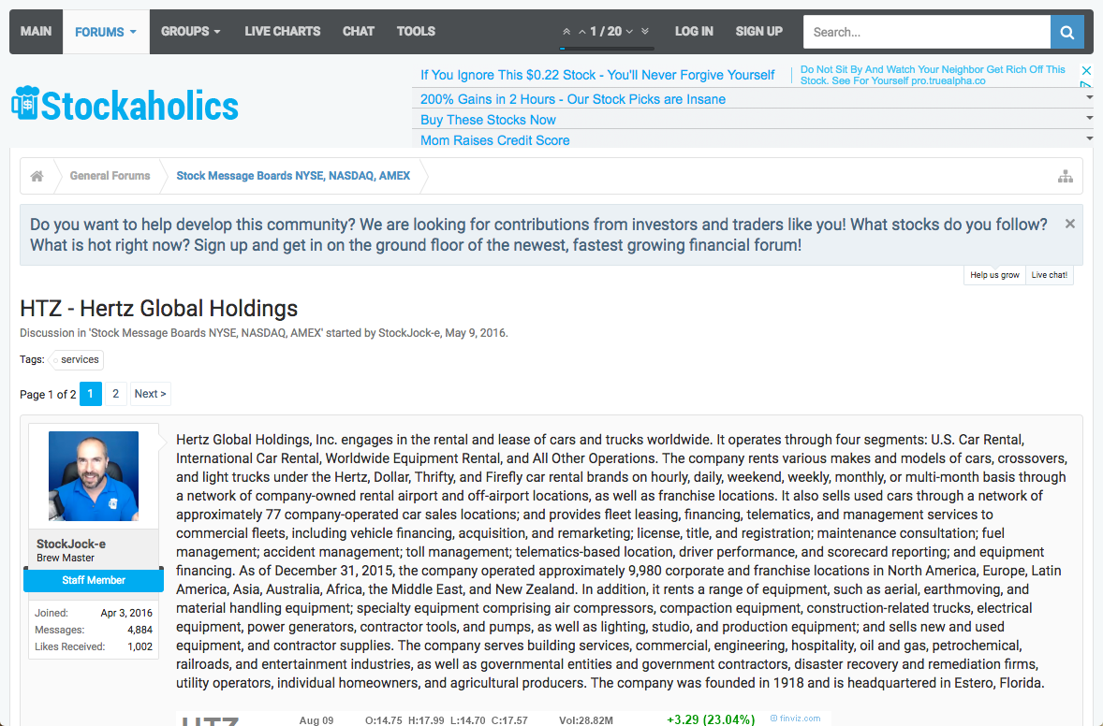
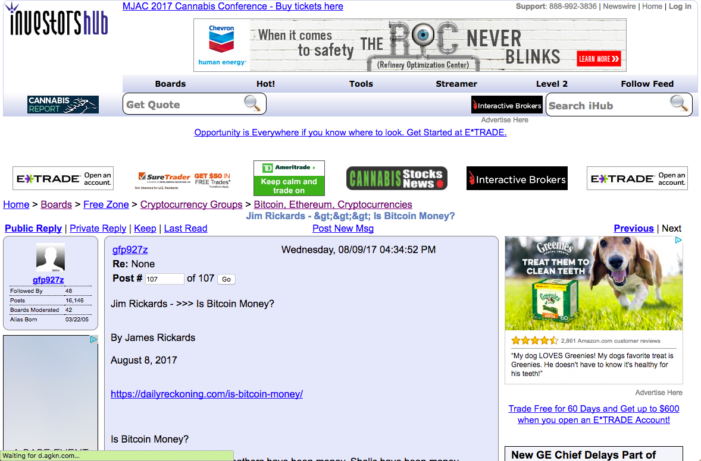
Scope
Genre specific
(e.g., forums)
Web site specific
Wide, non-specific

Slide 62
Pattern Complexity E.g., word patterns
Closed set
Regular set
U.S. states
U.S. phone numbers
He was born in Alabama…
Phone: (413) 545-1323
The big Wyoming sky…
The CALD main office can be reached at 412-268-1299
Complex pattern
Ambiguous patterns, needing context and many sources of evidence
“YOU don't wanna miss out on ME :) Perfect lil booty Green eyes Long curly black hair Im a Irish, Armenian and Filipino mixed princess :) ❤ Kim ❤ 7○7~7two7~7four77 ❤ HH 80 roses ❤ Hour 120 roses ❤ 15 mins 60 roses”
U.S. postal addresses
University of Arkansas
P.O. Box 140
Hope, AR 71802
Person names
…was among the six houses sold by Hope Feldman that year.
Headquarters:
1128 Main Street, 4th Floor
Cincinnati, Ohio 45210
Pawel Opalinski, Software Engineer at WhizBang Labs.
Courtesy of Andrew McCallum
Notes:
How complicated a modeling technique will you have to use?

Slide 63
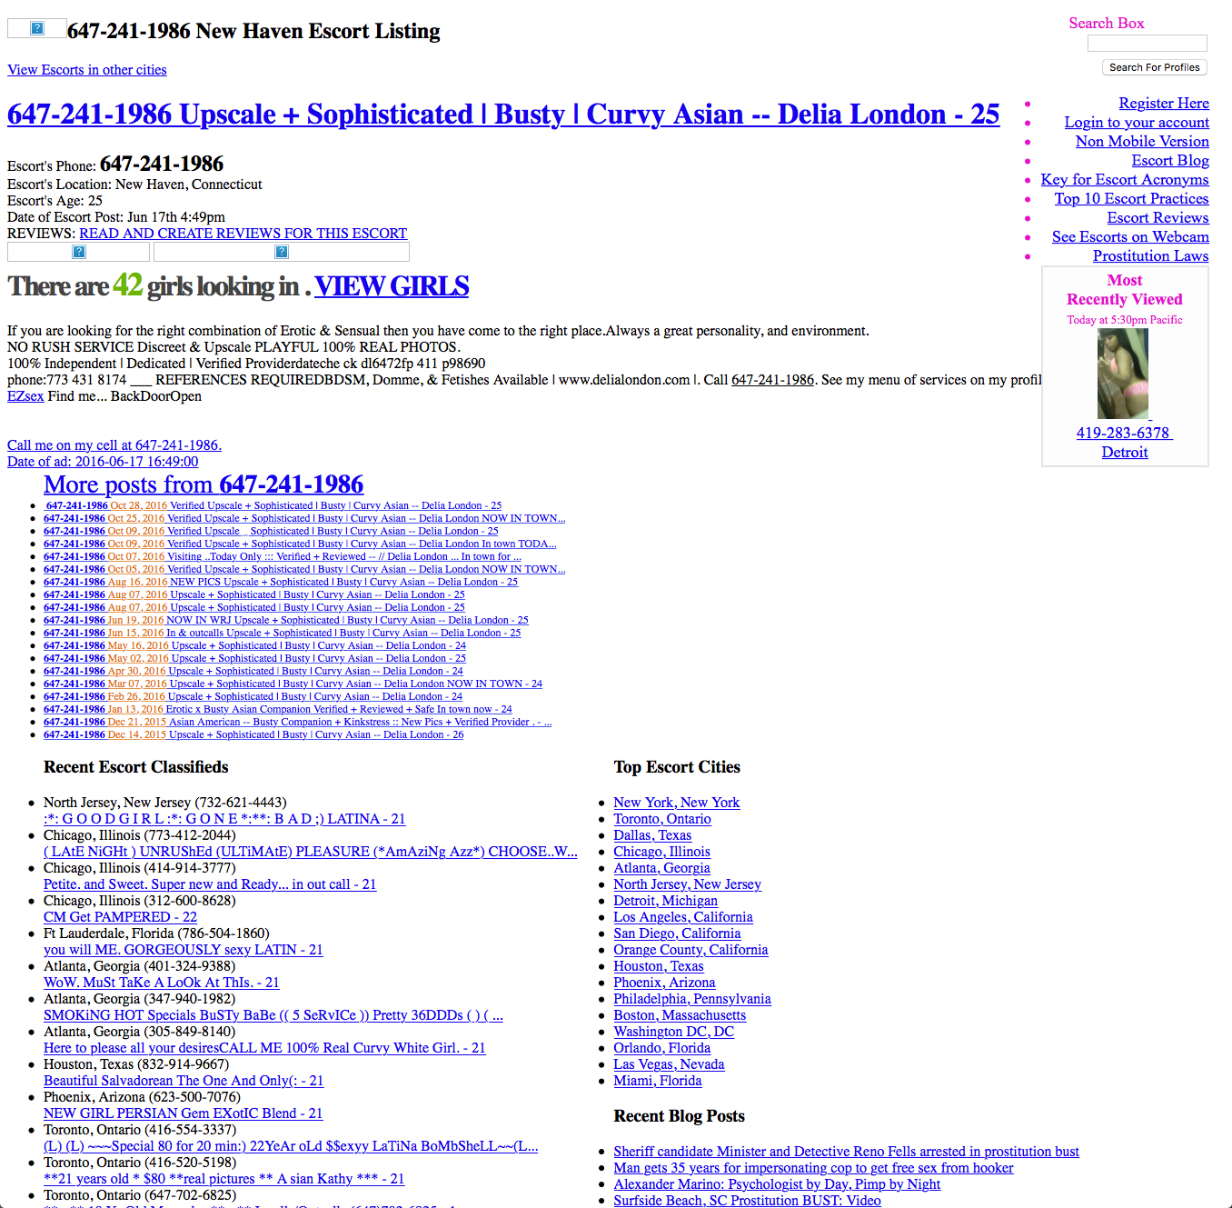
small amount of relevant content irrelevant content very similar to relevant content

Slide 64
IE In Unusal Domains Full spectrum of in all dimensions
Document Features | Scope | Pattern Complexity | Relevance
text paragraphs grammatical, some formatting ungrammatical, rich formatting tables charts | website specific genre-specific wide | closed set regular set complex pattern ambiguous pattern unusual language model | all relevant significant irrelevant content active deception purposeful obfuscation
How to adapt existing techniques without much supervision?

Slide 65
currently, only one universal extractor

Slide 66
Practical Considerations
How good (precision/recall) is necessary?
High precision when showing extractions to users
High recall when used for ranking results
How long does it take to construct?
Minutes, hours, days, months
What expertise do I need?
None (domain expertise), patience (annotation), simple scripting, machine learning guru
What tools can I use?
Many …

Slide 67
Practical IE Technologies
 | Glossary | Regex | NLP Rules | Semi- Structured | CRF | NER | Table
Effort | assemble glossary | hours | hours | minutes | O(1000) annotations | zero | O(10) annotations
Expertise | minimal | high, programmer | low | minimal | low-medium | zero | minimal
Precision | medium (ambiguity) | high | high | high | medium-high | medium-high | high
Recall | medium (formatting) | low f(# regex) | medium f(# rules) | high | medium | medium | high
Coverage | wide | wide | wide | single site | genre | news wire | narrow

Slide 68
Case Study
Combating fraud in the penny stock market

Slide 69
Microcap Stock Fraud
Microcap stock fraud is a form of securities fraud involving stocks of "microcap" companies, generally defined in the United States as those with a market capitalization of under $250 million. Its prevalence has been estimated to run into the billions of dollars a year.
Pump and dump schemes, involving use of false or misleading statements to hype stocks, which are "dumped" on the public at inflated prices. Such schemes involve telemarketing and Internet fraud
https://en.wikipedia.org/wiki/Microcap_stock_fraud

Slide 70
Most Relevant Websites
4-traders.com
advfn.com
analystratings.net
barchart.com
bitcointalk.org
blogspot.com
blogspot.in
businessinsider.com
businessprofiles.com
dividend.com
dynamoo.com
etf.com
facebook.com
fifighter.com
financialcontent.com
finanzen.nl
finanzen100.de
hotstocked.com
index.co
investorshangout.com
marketnewscall.com
marketwatch.com
minyanville.com
moneyhub.net
nasdaq.com
openpr.com
otcmarkets.com
pennystock101.org
pennystocktweets.com
pinkinvesting.com
prnewswire.com
rumas.de
sify.com
siliconinvestor.com
stockguru.com
stockopedia.com
stockreads.com superstockscreener.com tdameritrade.com
thehotpennystocks.com
thelion.com
theotc.tod
traders.com
trading-treff.de
twitter.com
uservoice.com
wikinvest.com
yahoo.com

Slide 71
Microcap Fraud Ontology defined by two SEC users in 45 minutes
Property | Description
address | US postal service address
city | specific cities mentioned in a page
compensation_amount | amount a promoter was compensated
counsel | counsel
country | countries mentioned in a page
date_of_post | post date of the blog or article
disclaimer | disclaimer in promotion
email | email addresses mentioned in the page
industry | industry of organization
market | stock market of the issuer
message_board | name of message board
message_board_category | category of the message board
organization_name | name of the organization
Property | Description
org_registration_date | date organization was created
org_registration_number | state registration number for the organization
organization_status | status of the organization's state registration
paying_party | entity that is paying for the promotion
phone | phone numbers mentioned in the page
posted_date | any date mentioned in a page
promoter_name | name of the promoter
state | specific states mentioned in a page
stock_ticker | stock tickers mentioned in the page
twitter_tag | tags in a tweet
user_registration_date | date the user registered for the site
username | user name in a website
website | website where page was published

Slide 72
myDIG Demo setting up a new domain (after crawling)
Specifying websites
Defining the domain ontology
Defining extractors
Building the knowledge graph
Customizing the search engine
Notes:
http://52.36.12.77:8091/entity.html?domain=sec_domain&id=lgyv&type=stock_ticker
http://52.36.12.77:8091/entity.html?domain=sec_domain&id=dg%20penny%20picks&type=promoter_name
search for “act now” find ticker “LGYV”

Slide 73
Featured Extractors
 | Glossary | Regex | NLP Rules | Semi- Structured | CRF | NER | Table
Effort | assemble glossary | hours | hours | minutes | O(1000) annotations | zero | O(10) annotations
Expertise | minimal | high, programmer | low | minimal | low-medium | zero | minimal
Precision | medium (ambiguity) | high | high | high | medium-high | medium-high | high
Recall | medium (formatting) | low f(# regex) | medium f(# rules) | high | medium | medium | high
Coverage | wide | wide | wide | single site | genre | news wire | narrow

Slide 74
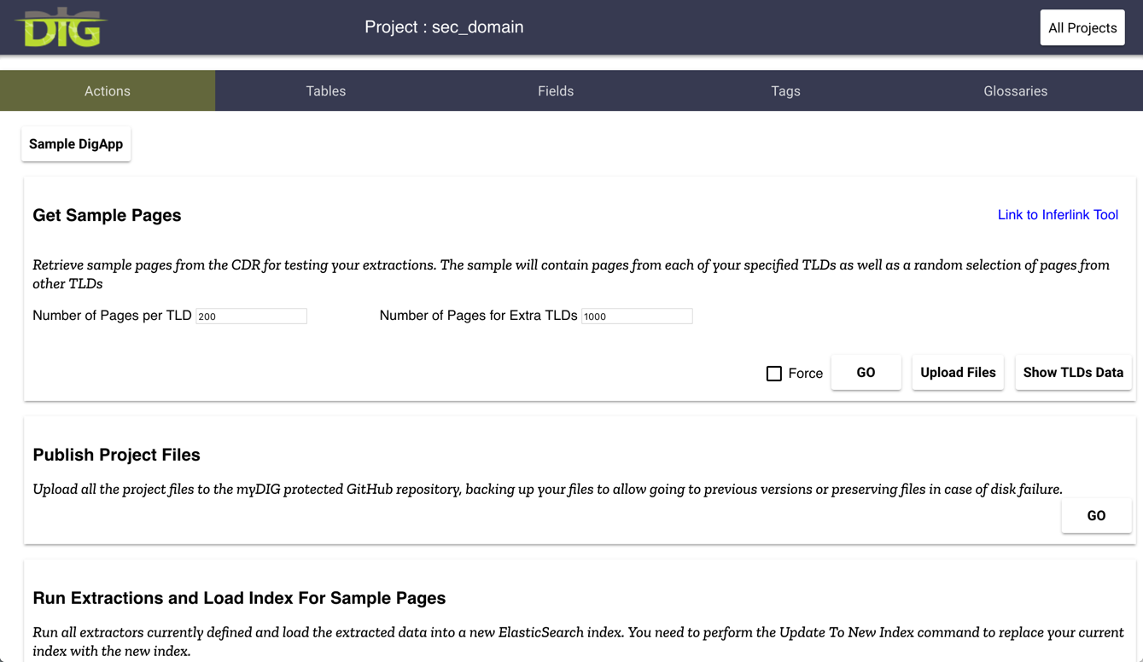
DEMO

Slide 75
Inferlink Extractor
Automatic extraction from semi-structured pages https://github.com/inferlink

Slide 76
Inferlink Extractor
Infer
Extractor
Infer
Extractor
Classify by
Templates
Infer
Extractor
Infer
Extractor
input:
a pile of pages
pages clustered
by template
extractor

Slide 77
Inferlink Extraction Accuracy firearms domain, 10 websites, 5 pages each
fields
 | Title | Desc | Seller | Date | Price | Loc | Cat | Member Since | Expires | Views | ID
Perfect | 1.0 (50/50) | .76 (37/49) | .95 (40/42) | .83 (40/48) | .87 (39/45) | .51 (23/45) | .68 (34/50) | 1.0 (35/35) | .52 (15/29) | .76 (19/25) | .97 (35/36)
Pretty Good | 1.0 (50/50) | .98 (48/49) | .95 (40/42) | .83 (40/48) | .98 (44/45) | .84 (38/45) | .88 (44/50) | 1.0 (35/35) | .55 (16/29) | 1.0 (25/25) | 1.0 (36/36)
Pretty Good: useful to user
extra tokens present
non-essential tokens missing

Slide 78
Glossary Extraction
Simple in principle
list of words or phrases to extract
Challenges
Ambiguity: Charlotte is a name of a person and a city
Colloquial expressions: “Asia Broadband, Inc.” vs “Asia Broadband”
Research
Improving precision of glossary extractions
Extending glossaries automatically

Slide 79
Extraction Using Regular Expressions
Too difficult for non-programmers
regex for North American phone numbers:
^(?:(?:\+?1\s*(?:[.-]\s*)?)?(?:\(\s*([2-9]1[02-9]|[2-9][02-8]1|[2-9][02-8][02-9])\s*\)|([2-9]1[02-9]|[2-9][02-8]1|[2-9][02-8][02-9]))\s*(?:[.-]\s*)?)?([2-9]1[02-9]|[2-9][02-9]1|[2-9][02-9]{2})\s*(?:[.-]\s*)?([0-9]{4})(?:\s*(?:#|x\.?|ext\.?|extension)\s*(\d+))?$
Brittle and difficult to adapt to unusual domains
unusual nomenclature and short-hands
obfuscation

Slide 80
NLP Rule-Based Extraction
Tokenization for unusual domains
tokenize on white-space, punctuation and emojis
Token properties
literal, part of speech tag, lemma, in/out of dictionary
dependency parsing relationships (advanced)
type (alphanumeric, alphabetic, numeric)
shape (pattern of digits and characters), capitalization, prefix and suffix
number of characters, range (numbers)
Pattern
Sequence of required/optional tokens
positive and negative patterns

Slide 81
Named Entity Recognizers
Machine learning models (Conditional Random Field)
people, places, organizations and a few others
SpaCy
complete NLP toolkit, Python (Cython), MIT license
code: https://github.com/explosion/spaCy
demo: http://textanalysisonline.com/spacy-named-entity-recognition-ner
Stanford NER
part of Stanford’s NLP software library, Java, GNU license
code: https://nlp.stanford.edu/software/CRF-NER.shtml
demo: http://nlp.stanford.edu:8080/ner/process

Slide 82
myDIG: A KG Construction Toolkit Python, MIT license, https://github.com/usc-isi-i2
Enable end-users to construct domain-specific KGs
end users from 5 government orgs constructed KGs in less than one day
Suite of extraction techniques
semi-structured HTML pages, glossaries, NLP rules, NER, tables (coming soon)
KG includes provenance and confidences
enable research to improve extractions and KG quality
Scalable
runs on laptop (~100K docs), cluster (> 100M docs)
Robust
Deployed to many law enforcement agencies
Easy to install
Aug 31 2017: Docker deployment with single “docker componse up” installation

Slide 83
Knowledge Graph Completion
Our thanks to Lise Getoor for some slides on Entity Resolution and PSL
Notes:
Maybe list some acknowledgements

Slide 84
Problem
Extractions are noisy
Noise is not random
Postal code got extracted as phone
Email ID, social network ID got interchanged
Entity Disambiguation: Charlotte, NC vs. Charlotte the person
Complete the knowledge graph by inferring wrong links, new links

Slide 85
Some solutions we’ll cover today
Entity Resolution (ER)
Probabilistic Soft Logic (PSL)
Knowledge Graphs in Latent Space aka knowledge graph embeddings

Slide 86
Entity Resolution (ER)
Notes:
Maybe list some acknowledgements

Slide 87
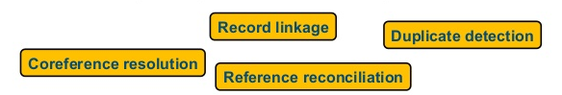
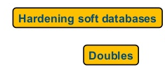

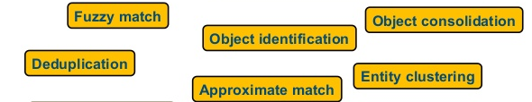

Entity Resolution (ER)
The problem of clustering mentions that refer to the same underlying entity

Slide 88
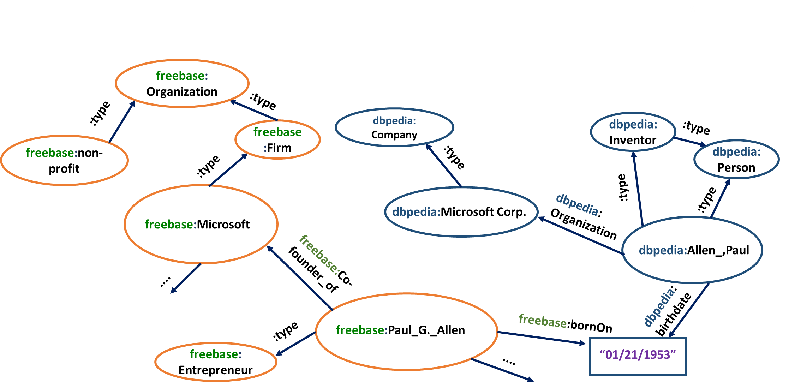
Example: Linking Dbpedia to Freebase

Slide 89
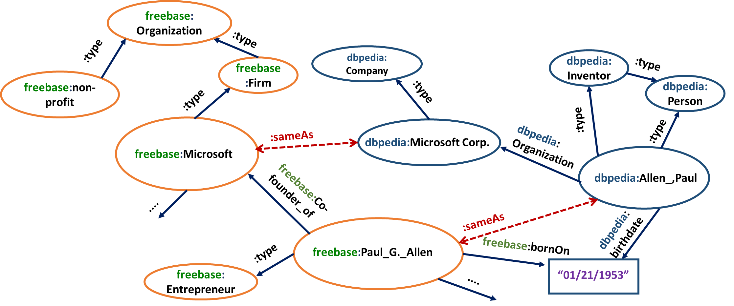
Knowledge graphs contain duplicate entities

Slide 90
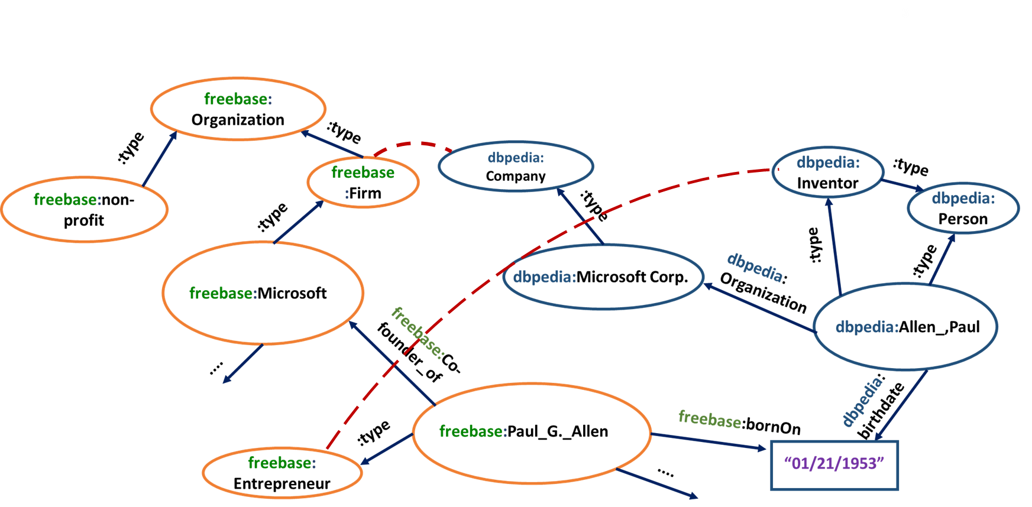
Knowledge graph nodes are multi-type

Slide 91
How to do ER?
Popular methods use some form of machine learning; see surveys by Kopcke and Rahm (2010), Elmagarmid et al. (2007), Christophides et al. (2015)
Probabilistic Matching Methods
M
Active Learning
M
Supervised,
Semi-supervised
Rule Based
Distance Based
Unsupervised
EM
Winkler (1993)
Hierarchical Graphical Models
Ravikumar and Cohen (2004)
SVM
Christen (2008)
Marlin (SVM based)
Bilenko and Mooney (2003)
Notes:
Add citations, links

Slide 92
With graph representation
Can propagate similarity decisions Melnik, Garcia-Molina and Rahm (2002)
More expensive but better performance
Can be generic or use domain knowledge e.g., citation/bibliography domain Bhattacharya and Getoor (2006,2007)

Slide 93
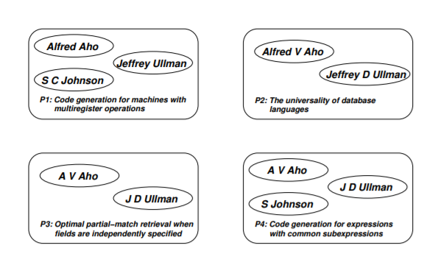
Example (co-authorship)
Bhattacharya and Getoor (2006,2007)

Slide 94
Feature functions - I
First line of attack is string matching
Character based
Token based
Phonetic based
Edit Distance
Affine Gap
Smith-Waterman
Jaro
Q-gram
Monge Elkan
TF-IDF
Soft
Q-gram
Jaccard
Soundex
NYSIIS
ONCA
Metaphone
Double Metaphone
Available Packages: SecondString, FEBRL, Whirl…

Slide 95
Feature functions - II
Unusual domains have many non-text fields Feature functions may have to be hand-crafted or learned from data:
Tracking numbers for mail fraud/narcotics
Review IDs for human trafficking
Stock tickers for SEC

Slide 96
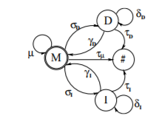
Learnable string similarity
Example: adaptive edit distance
Sets of equivalent string pairs (e.g., <Suite 1001, Ste. 1001>
Learned parameters
Bilenko and Mooney (2003)

Slide 97
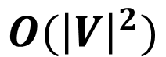
After training...
Apply classifier i.e. similarity function to every pair of nodes? Quadratic complexity!
Linked mentions
$$O({\left|V\right|}^{2})$$
applications of similarity function

Slide 98
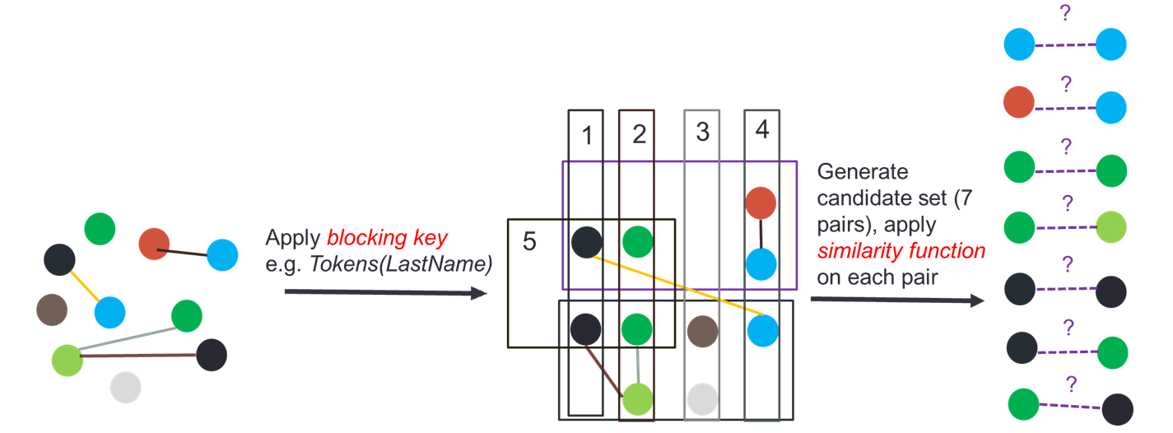
Blocking trick
Like a configurable inverted index function

Slide 99
What is a good blocking key?
Achieves high recall
Achieves high reduction
Good survey on blocking: Christen (2012)

Slide 100
How do we learn a good blocking key?
Key idea in existing work is to learn a DNF rule with indexing functions as atoms
CharTriGrams(Last_Name) U (Numbers(Address) X Last4Chars(SSN))
Michelson and Knoblock (2006), Bilenko, Kamath and Mooney (2006), Kejriwal and Miranker (2013; 2015)...

Slide 101
Putting it together: two-step ER
Training set of duplicates/non-duplicates
Entity Resolution
Blocking:
Blocking scheme learner+blocking method
Similarity:
machine learning, rules, heuristics, graph propagation
Candidate pairs
Graph inputs
Resolved entities

Slide 102
ER packages
Not many, still tend to be inefficient or for specific domain
FEBRL was designed for biomedical record linkage (Christen, 2008)
Dedupe crashes on graphs with fewer than a million nodes https://github.com/dedupeio/dedupe
LIMES, Silk mostly designed for RDF data, often require pre-specified similarity functions (Ngonga Ngomo and Auer, 2008; Isele et al. 2010)

Slide 103
Not all attributes are equal
Phones/emails important in human trafficking
(names are unreliable)
Names can be important in SEC
(nothing special about phones)
How do we use this knowledge?
Notes:
Too busy perhaps?

Slide 104
Domain knowledge
Especially important for unusual domains but how do we express and use it?
Use rules? Too brittle, don’t always work!
Use machine learning? Training data hard to come by, how to encode rule-based intuitions?

Slide 105
Probabilistic Soft Logic (PSL)
Notes:
Maybe list some acknowledgements

Slide 106
Practical methods to resolve logic/probability dilemma
Statistical Relational Learning (SRL)
Stochastic Logic Programs (SLPs) Muggleton (1996)
Probabilistic Relational Models (PRMs) Koller (1999)
Bayesian Logic Programs (BLPs) Kersting and De Raedt (2001)
Markov Logic Networks (MLNs) Richardson and Domingos (2006)
Probabilistic Soft Logic (PSL) Kimmig et al., (2012)
Notes:
Add a graphic

Slide 107
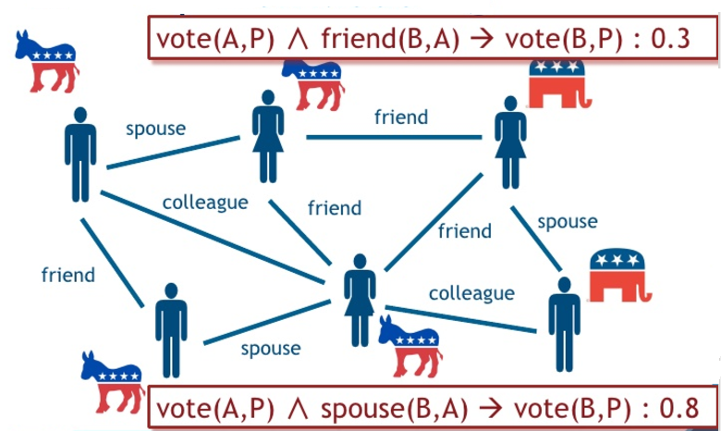
Intuitive example (PSL)

Slide 108
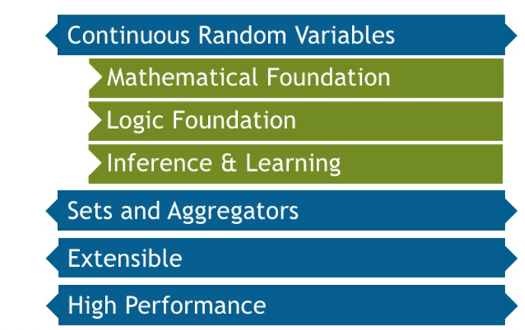
Why PSL?

Slide 109
Probabilistic Soft Logic (PSL)
Good framework for expressing domain constraints
Code available, many tutorials and videos on how to get started
http://psl.linqs.org/index.html

Slide 110
Rules need to be pre-specified
But weights can be learned from training data
Some recent work has also tried to learn rules (but may lose interpretability)
$$vote\left(A,P\right) ∧friend\left(B,A\right)→vote\left(B, P\right):?$$
$$vote\left(A,P\right) ∧spouse\left(B,A\right)→vote\left(B, P\right):?$$
Notes:
Some symbols/graphics...

Slide 111
Case Study: Toponym Resolution
Toponym resolution: resolving extracted location mention to a canonical geolocation in a KB like GeoNames
Applied to human trafficking domain
...I’m from beautiful downtown London in Ontario, Canada...
Notes:
Use example...

Slide 112
Rules for toponym resolution
Can easily encode rules (in PSL) such as a city can only be in one state and one country, a city must actually exist in a state and country...
Use elements like population to assign weights

Slide 113
Knowledge Graphs in Latent Space

Slide 114
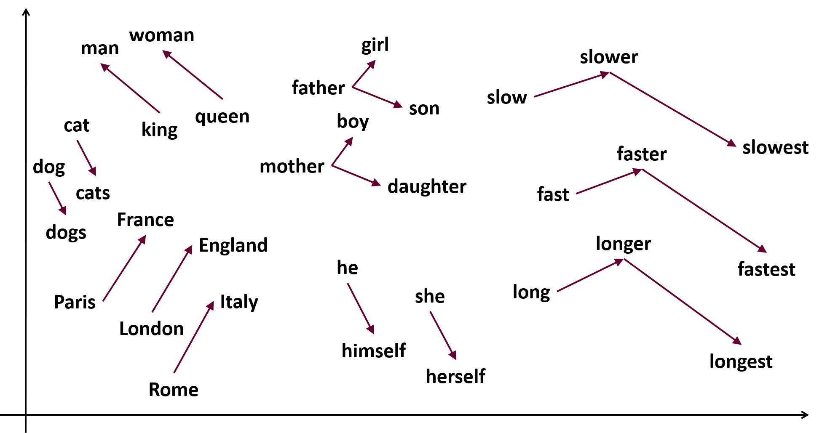
Low-dimensional vector spaces
Very popular for documents, graphs, words...

Slide 115
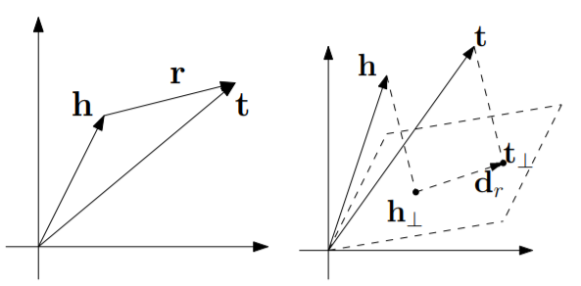
Knowledge graph embeddings
Many ways to model the problem: entities are usually vectors, relations could be vectors or matrices
TransE
TransH

Slide 116
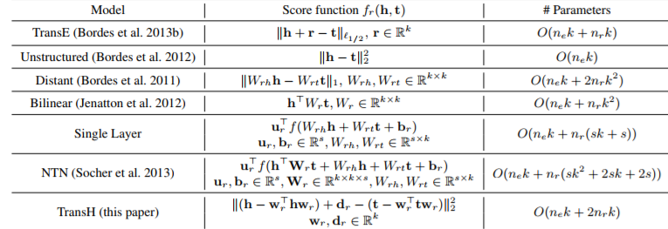
Objective/loss/energy functions
What is an ‘optimal’ vector/matrix for an entity or relation?

Slide 117
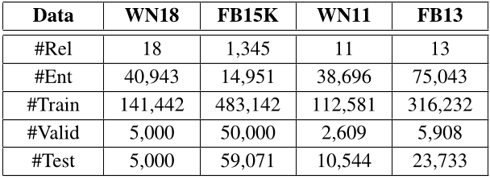
Existing work
Typically evaluate on Freebase and WordNet
Wang et al. (2008)

Slide 118
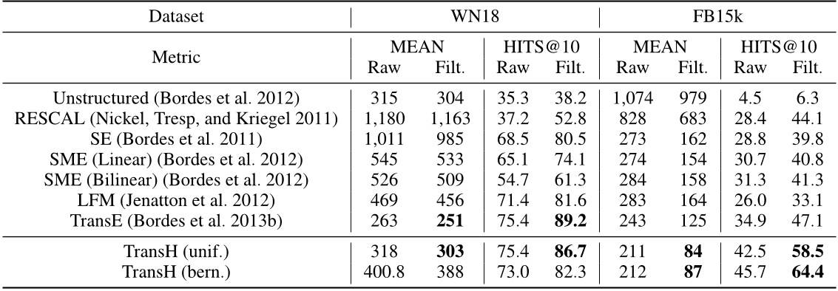
Application 1: Triples completion
Wang et al. (2008)

Slide 119
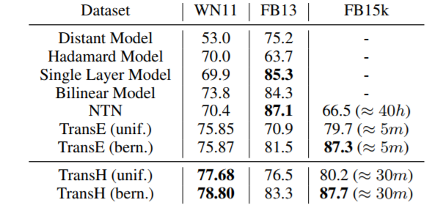
Application 2: Triples classification
Wang et al. (2008)

Slide 120
Code availability
Code for replicating experiments can be found at https://github.com/glorotxa/SME ; implemented using both theano/tensorflow backend
Unclear how to extend to new, sparse data, how to scale to much bigger KGs

Slide 121
Application 3: Featurizing nodes
E.g. Convering ‘locations’ into feature vectors
Relevant for toponym resolution, building rich graphs...
Kejriwal, Mayank; Szekely, Pedro (2017): Neural Embeddings for Populated GeoNames Locations. figshare. https://doi.org/10.6084/m9.figshare.5248120
https://github.com/mayankkejriwal/Geonames-embeddings
Notes:
Add a graphic

Slide 122
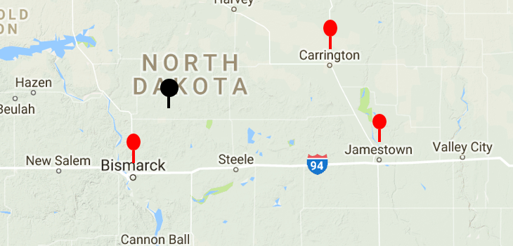
Features encode spatial proximity
But could encode much else, lots of room for new research!

Slide 123
In unusual domains...
Not clear to what extent these techniques work (which objective function is better?)
Several questions persist
How to acquire training data for triples classification?
How to model the concept of an entity?
How to regularize with sparse mentions?
Notes:
Mention weak supervision and active learning as possible solutions

Slide 124
Searching Knowledge Graphs

Slide 125
Motivation
Direct query execution does not succeed because of noise/incomplete data
What is the phone number provided in the ad that contains the email address brianna.elite@dummy-email.com, the price $600/hour, and the location manhattan midtown east 33rd & 2nd ave?

Slide 126
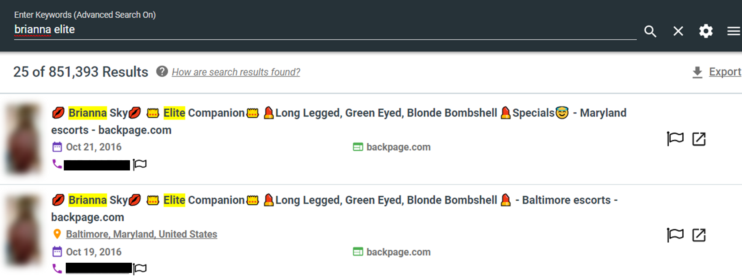
Keyword vs. faceted search

Slide 127
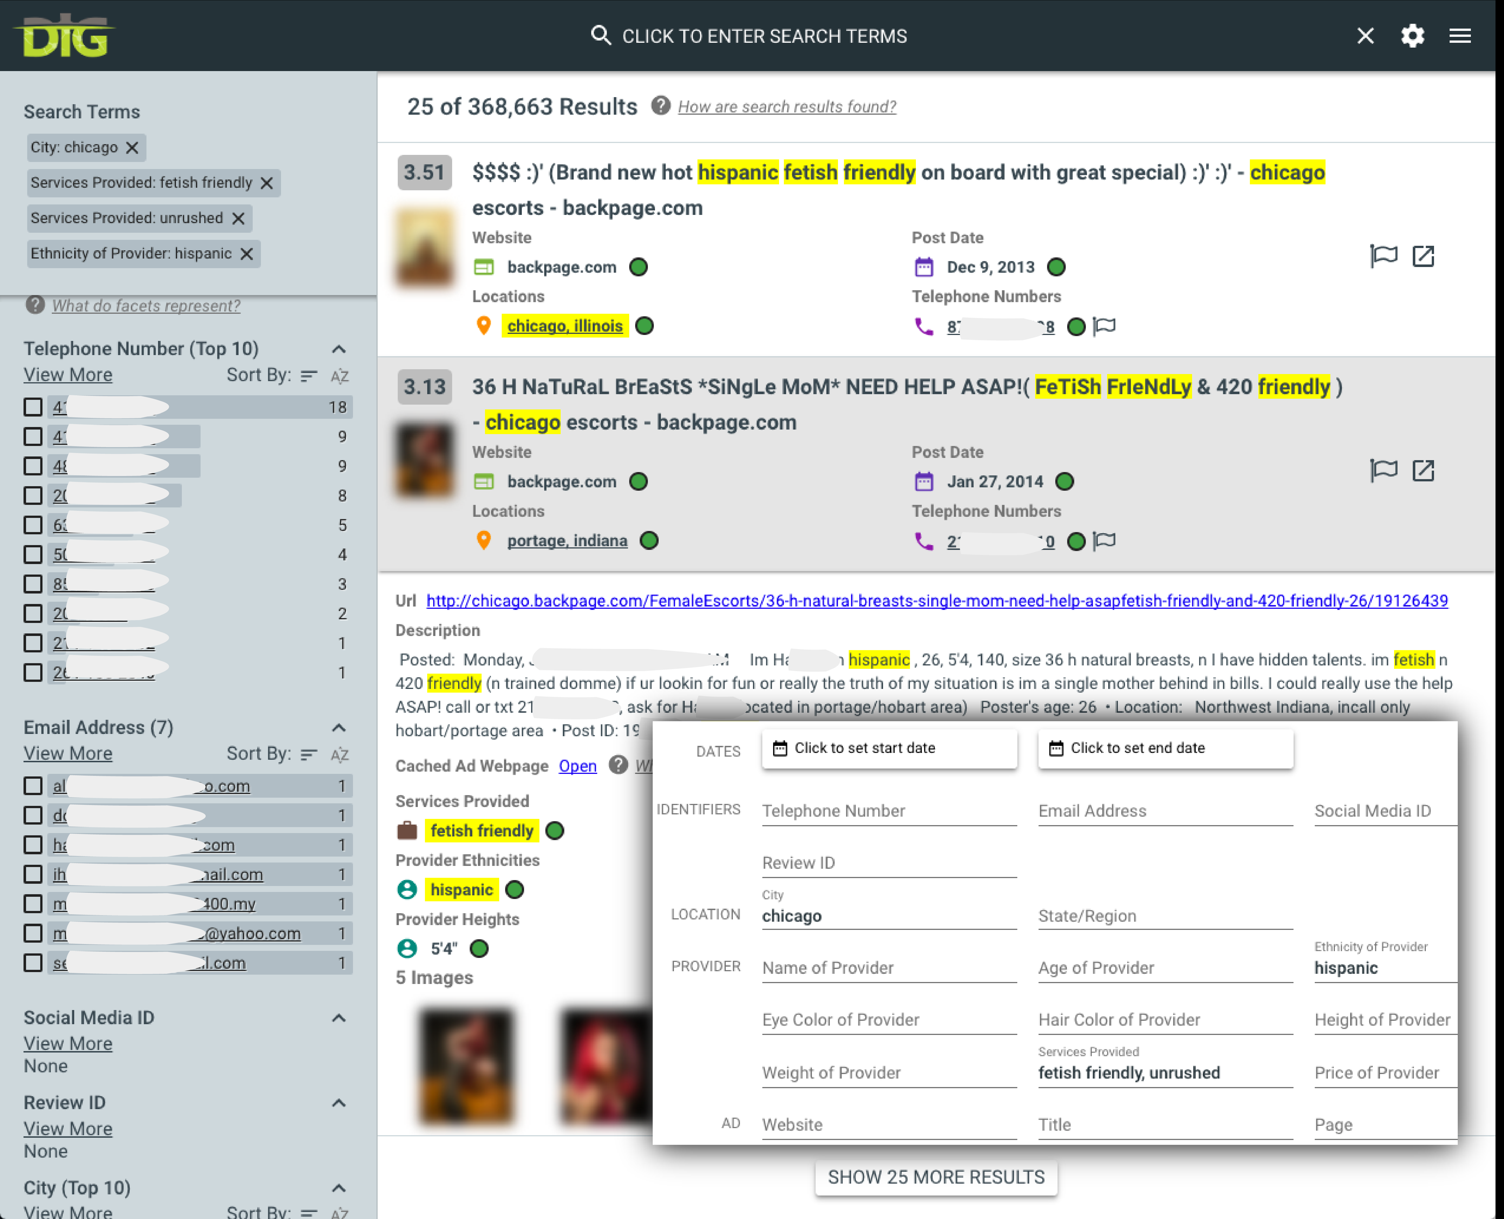
Faceted search form

Slide 128
Other kinds of search: many research opportunities
Clustering and network queries
Find all massage parlor ads linked either directly or indirectly to phone 12345678
Aggregate queries
Find the most common ethnicity in the massage parlor ads linked either directly or indirectly to phone 12345678

Slide 129
Key technique: Query reformulation
Traditional work tends to reformulate if original query returns no results
Does not work well in presence of noise or in interactive session
Use weighted combination of reformulated queries instead, execute in NoSQL database

Slide 130
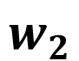
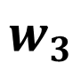
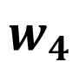

Semantic Query Reformulation
Original query
Knowledge graph stored in NoSQL database
$$w_{1}$$
$$w_{2}$$
$$w_{3}$$
$$w_{4}$$
Conservative
Relaxed
Keyword-only
…
Execute
Weighted tree of semantically reformulated queries
Ranked list of results

Slide 131
Other applicable techniques
Entity set learning and expansion
E.g., can expand red to red, auburn, fiery...
Use machine learning to learn weights of reformulated sub-queries
Relatively unexplored research area: similar to learning to rank in IR community, but weights strategies, not features

Slide 132
Wrap up and review
Notes:
10-20 slides

Slide 133
Summary
Unusual domains
Interesting, fun, high social impact
Knowledge graphs
Wide-spectrum of representations
Knowledge graph construction
Many tools to help, easy to create interesting graphs
Case study
Tools make it possible to build a KG in a day
Knowledge graph completion
Inferring wrong and missing links
Entity resolution
Clustering/linking mentions referring to the same underlying entity
Probabilistic soft logic
Correcting outputs of KG construction and entity resolution through logical probabilistic rules
KGs in latent space
Performing inference in low-dimensional vector spaces
Searching knowledge graphs
Using semantic query reformulation to answer complex queries over noisy knowledge graphs

Slide 134
Thank you!

